Slide 1
Fine-tuning RoBERTa on SemEval-2023 Task 4: Human Value Detection
Presenter: Choi Wai Lap

Slide 2
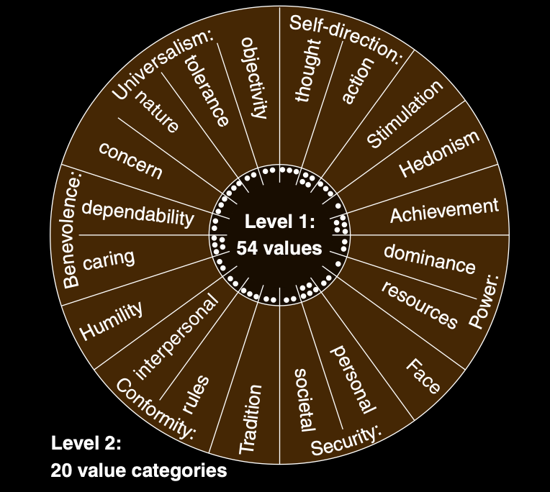
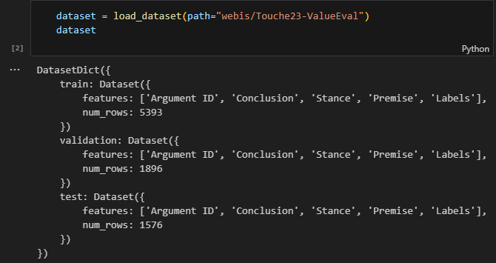
SemEval-2023 Task 4
Identification of Human Values Behind Arguments

Slide 3
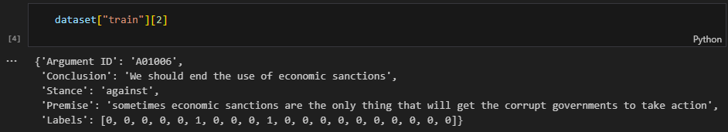
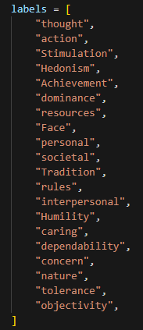
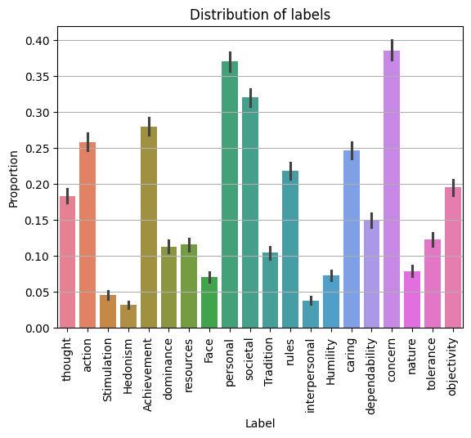
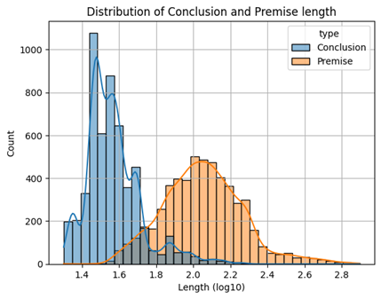
SemEval-2023 Task 4
Multi-label multi-class classification task

Slide 4
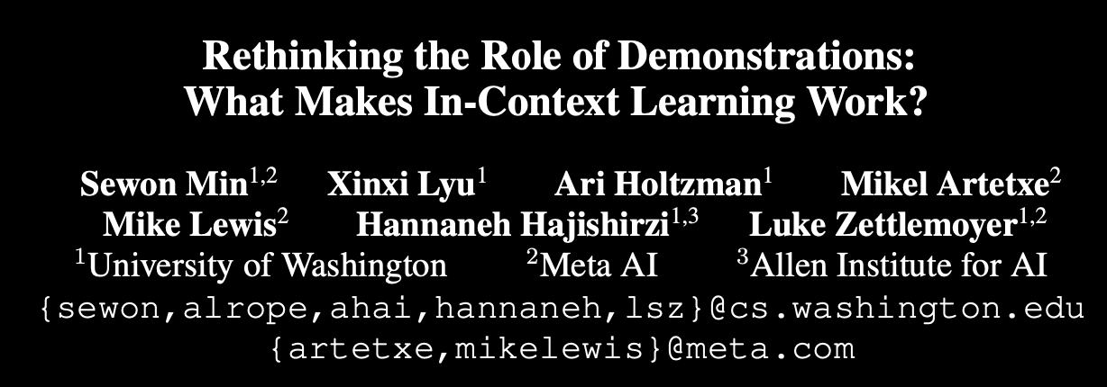

In-Context Learning
Using OOD inputs instead of inputs from training data significantly drops the performance.
$∴$In-distribution inputs in the demonstrations substantially contribute to performance gains, since LM always conditioned on in-distribution data during pre-training $⇒$ MLM on training data to shift the distribution

Slide 5
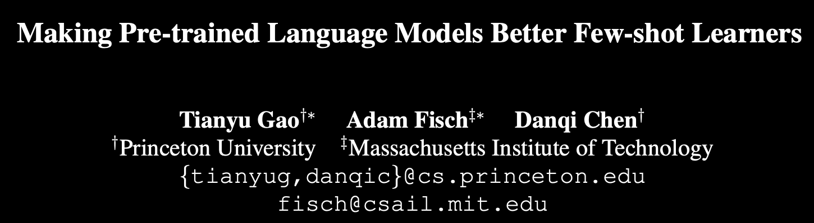
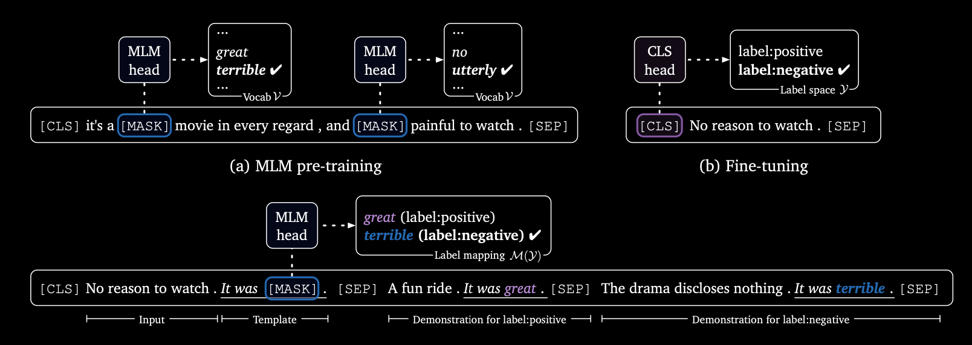
Prompt-Based Fine-tuning

Slide 6
Prompt-Based Fine-tuning
Conclusion | Stance | Premise | Label
We should ban human cloning | in favor of | we should ban human cloning as it will only cause huge issues when you have a bunch of the same humans running around all acting the same. | 0, 0, 0, 0, 0, 0, 0, 0, 0, 1, 0, 0, 0, 0, 0, 0, 0, 0, 0, 0
We should end the use of economic sanctions | against | sometimes economic sanctions are the only thing that will get the corrupt governments to take action. | 0, 0, 0, 0, 0, 1, 0, 0, 0, 1, 0, 0, 0, 0, 0, 0, 0, 0, 0, 0
Model Input
Premise is that We should ban human cloning. Conclusion is that we should ban human cloning as it will only cause huge issues when you have a bunch of the same humans running around all acting the same. So, is the context related to the <MASK>?
Premise is that We should end the use of economic sanctions. Conclusion is that sometimes economic sanctions are the only thing that will get the corrupt governments to take action. So, is the context related to the <MASK>?

Slide 7
Result
Model | Size | Setting | Accuracy | Micro F1 | Micro Precision | Micro Recall
RoBERTa | Base | Baseline | 43 | 54 | 60 | 50
 |  | MLM + F.T. | 43 | 54 | 60 | 50
 | Large | MLM + F.T. | 46 | 58 | 63 | 53
 |  | MLM Prompt-based | 47 | 59 | 65 | 54
 |  | ↑Balanced | 47 | 59 | 67 | 53
DeBERTa |  | Prompt Based Bal-anced | 45 | 57 | 62 | 52
 |  | MLM Prompt Based Balanced | 44 | 55 | 60 | 50

